Slide 1

Anticipating Potential Illnesses Through Predictive Models using machine learning

Slide 2

TEAM-
Basani Shashanka(2103A52005)
Polsani Chaithra Sri(2103A52027)
Chidurala Ashwini(2103A52028)
Katha Sravani(2103A52085)
Munja Sriharsha(2103A52098) Under the guidance of
Dr Pramod Kumar Poladi
Computer Science and Artificial Intelligence

Slide 3
ABSTRACT
This study aims to develop a machine learning model for predicting 42 diseases based on 132 symptoms. The goal is to train a model on the training data and evaluate its performance on the testing data. However, existing methods of disease prediction are often limited by the availability and quality of health data, as well as the complexity and diversity of diseases. In this paper, we propose a novel machine learning framework for disease prediction and improvement, based on the integration of data sources, such as symptoms. This study presents the development of a machine learning model for disease prediction across a spectrum of medical conditions. the model aims to accurately forecast the likelihood of individuals developing various diseases, including but not limited to cardiovascular diseases, diabetes, cancer, and neurological disorders. The proposed model integrates state-of-the-art machine learning algorithms, including gradient boosting, voting model, ANN to effectively capture complex patterns and interactions within the data. By accurately predicting diseases based on symptoms, this study can significantly assist physicians and improve healthcare outcomes. We demonstrate that our framework can achieve high accuracy and robustness in disease prediction, as well as provide meaningful and actionable insights for disease prevention and management.

Slide 4
Introduction
The growing interest in machine learning and deep learning has led to significant advancements in various fields, including medical science. Disease prediction, utilizing advanced technologies and data analytics, has emerged as a crucial frontier in healthcare, revolutionizing the way we approach prevention and early intervention. By leveraging machine learning algorithms, big data analytics, and genetic profiling, healthcare professionals can now forecast the likelihood of individuals developing specific diseases, thereby enabling proactive measures to mitigate risks and enhance overall public health outcomes. Disease prediction stands at the forefront of modern healthcare, offering transformative opportunities to enhance preventive care, personalize medical interventions, and improve population health outcomes. As technology continues to advance and our understanding of disease mechanisms deepens, the role of disease prediction is poised to become even more central in shaping the future of healthcare delivery.

Slide 5
DOMAIN KNOWLEDGE
HEALTHCARE AND MACHINE LEARNING
The healthcare domain is a broad and diverse field that encompasses various aspects of health and well-being, such as prevention, diagnosis, treatment, and management of diseases and disorders, as well as research, education, policy, and innovation. Nowadays, the healthcare domain is undergoing rapid and significant changes due to the digital transformation and The demographic and epidemiological transitions factors.
Coming to machine learning, Machine learning and its applications in healthcare have gained a lot of attention. When enhanced computational power is combined with big data, there is an opportunity to use ML algorithms to improve health care. Various concepts related to ML need to be integrated into the medical curriculum so that health professionals can effectively guide and interpret research in this area.

Slide 6
MOTIVATION
We are committed to undertaking this machine learning project in the healthcare domain due to its potential to revolutionize patient care and medical practice .We want to use machine learning to help doctors take better care of patients. These project can look at a lot of data and predict things, like what sickness someone might have or what treatment could work best for them. We're excited because this could mean fewer mistakes in diagnosing illnesses and treatments that are more personalized to each person. We also want to use machine learning to make healthcare fairer for everyone, by making sure everyone gets the right care they need. Plus, we think we can discover new medical solutions by machine learning and help to practioners to learn more about diseases. Our goal is to make healthcare better for everyone.

Slide 7
PROBLEM STATEMENT
Building a machine learning model to predict different diseases based on symptoms for early detection of the disease to improve patient outcomes and prognosis. Using Machine learning models can reduce misdiagnosis and errors by identifying patterns and associations between symptoms and diseases, reducing unnecessary treatment and delays in care.

Slide 8
OBJECTIVES
Creating a disease prediction algorithm that can recognize different health issues based on different symptom profiles.
Developing a flexible tool that provides predictions for multiple scenarios, straying from the current models' emphasis on a particular illness.
To improve accuracy and early detection skills, make use of extensive datasets and cutting edge machine learning approaches.
Enhance patient outcomes by allowing early detection to provide prompt intervention for a variety of disorders.
Facilitate clinical diagnostic workflows by giving medical staff a dependable and effective tool for making decisions.

Slide 9
Existing system & Disadvantage of existing methodology
Several models currently in use make use of clinical data or patient-reported symptoms to forecast different diseases using symptom-based algorithms. These models do, however, frequently have shortcomings, such as poor accuracy brought on by symptom overlap between many illnesses, which can result in incorrect diagnoses or false alarms. Furthermore, individual differences in symptom presentation or illness development may not be taken into account by symptom-based models, which lessens their usefulness in individualized healthcare settings. Moreover, biases and errors can be introduced into the prediction process by depending on self-reported symptoms or insufficient clinical data, which compromises the validity of these models in practical applications.

Slide 10
Gaps identified
Restricted Scope: A large number of current models concentrate on forecasting a particular illness or a small subset of related diseases. This methodology could fail to consider the intricacy of shared symptoms among different illnesses, resulting in partial or imprecise forecasts.
Symptom Overlap: Predictive models may be confused by the common symptoms that many diseases share. The inability of current methods to reliably distinguish between illnesses with comparable symptom patterns raises the possibility of a misdiagnosis or a delay in receiving treatment.
Diversity and Quality of Data: The calibre and variety of the training data greatly influences the efficacy of symptom-based prediction models. Predictions' generalizability and reliability may be impacted by biases, inadequate records, or a lack of representation of particular demographics or geographic areas in the datasets that are currently available.

Slide 11
LITERATURE REVIEW
S.NO | Authors | Title | Demerits | Future Scope
1 | Sneha Grampurohit , Chetan Sagarnal | Disease Prediction using Machine Learning Algorithms | This may require additional resources and expertise to ensure the model remains effective and up-to-date. | Our future work investigates that how the proposed method can be extended to be applicable to the other types of datasets in medical domain.
2 | Dhiraj Dahiwade, Prof. Gajanan Patle, Prof. Ektaa Meshram | Designing Disease Prediction Model Using Machine Learning Approach | Here small volume data used for prediction like symptoms or previous knowledge obtained from the physical diagnosis. | They could not consider large dataset, now a days medical data is growing so needs to classify that and classification of that data is challenging.

Slide 12
3 | Shahadat Uddin1 , Arif Khan1, Md Ekramul Hossain1 and Mohammad Ali Moni | Comparing different supervised machine learning algorithms for disease prediction | The limitation is that they did not consider any sub classifications or variants of any of the algorithms considered in this study. | There is a need for more comprehensive comparative studies that evaluate the performance of different supervised machine learning algorithms for disease prediction.
4 | Mehrbakhsh Nilashi, Othman bin Ibrahim, Hossein Ahmadi, Leila Shahmoradi | An Analytical Method for Diseases Prediction Using Machine Learning Technique | All of the approaches used in this study, may not be applicable to other diseases classification problems | More attention should be paid to the dataset for disease classification and prediction using the incremental machine learning approaches

Slide 13
5 | K. Arumugama, Mohd Navedb, Priyanka P. Shindec, Orlando Leiva-Chaucad, Antonio Huaman-Osorioe, Tatiana Gonzales-Yanac | Multiple disease prediction using Machine learning algorithms | Limited availability of high-quality labeled dataset, especially for rare diseases | Research on interpretable machine learning models that provide transparent explanations for disease predictions
6 | Zengchen Yu1, KeWang,Zhibo Wan1, Shuxuan Xie1, Zhihan Lv | Popular deep learning algorithms for disease prediction | Poor interpretability Data imbalance Data quality issues Too little data | Incorporating Digital Twins Promoting precision medicine
7 | Abrar Yaqoob 1, Rabia Musheer Aziz 1 , Navneet Kumar Verma 1 and Pavan Kumar | A Review on Nature-Inspired Algorithms for Cancer Disease Prediction and Classification | Time-consuming and challenging | Advancing towards personalized cancer prediction models that consider individual patient characteristics, including genetic profiles, environmental factors, and treatment history.

Slide 14
8 | Weicheng Sun1, Ping Zhang1,Zilin Wang 1 and Dongxu Li | Prediction of Cardiovascular Diseases based on Machine Learning | ML models may overfit to the training data, capturing noise rather than true underlying patterns | ML models can be trained to tailor predictions and treatment recommendations to individual patients based on their unique risk factors and characteristics.
9 | Varsha Nemade1,Vishal Fegade | Machine Learning Techniques for Breast Cancer Prediction | Machine learning models trained on specific datasets may not generalize well to other populations which can limit their applicability and effectiveness in real-world clinical settings. | The future scope of this work is to perform hyper parameter tuning to improve the performance of the model.
10 | Gyanendra Chaubey1, Dhananjay Bisen1, Siddharth Arjaria1, Vibhash Yadav1 | Thyroid Disease Prediction Using Machine Learning Approache | Data quality and availability Limited scope | Conducting more rigorous validation and testing of machine learning models for thyroid disease prediction,

Slide 15
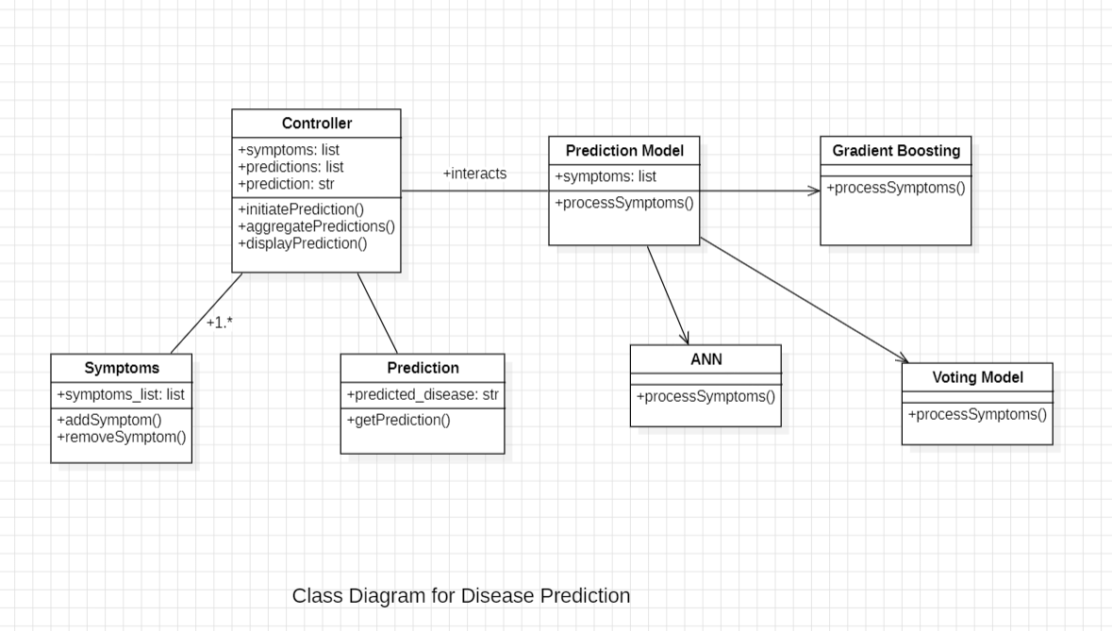
UML Diagrams

Slide 16
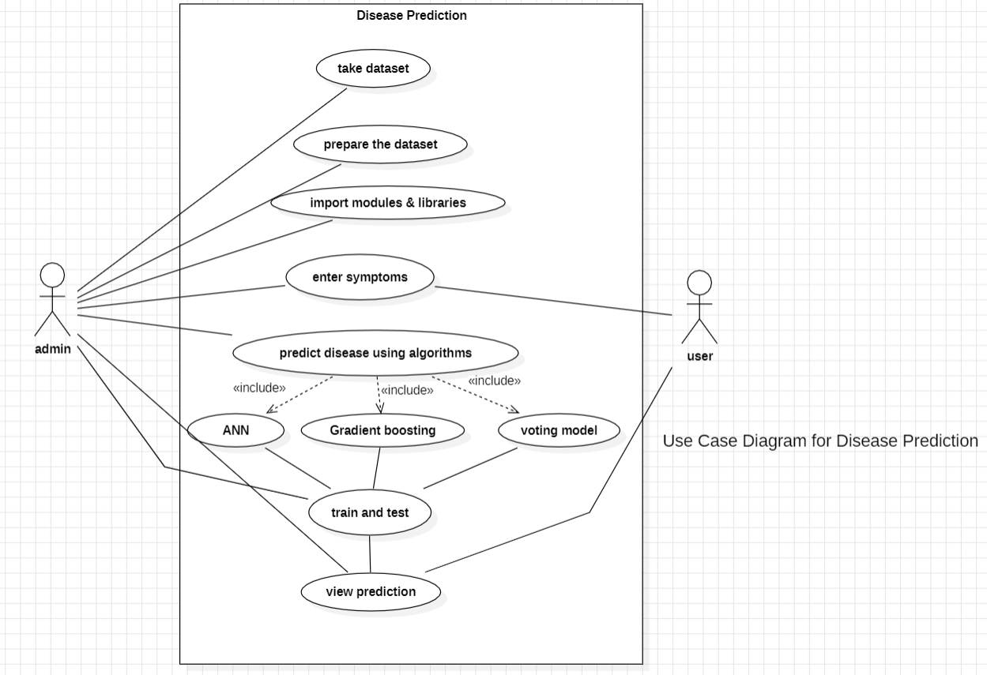

Slide 17
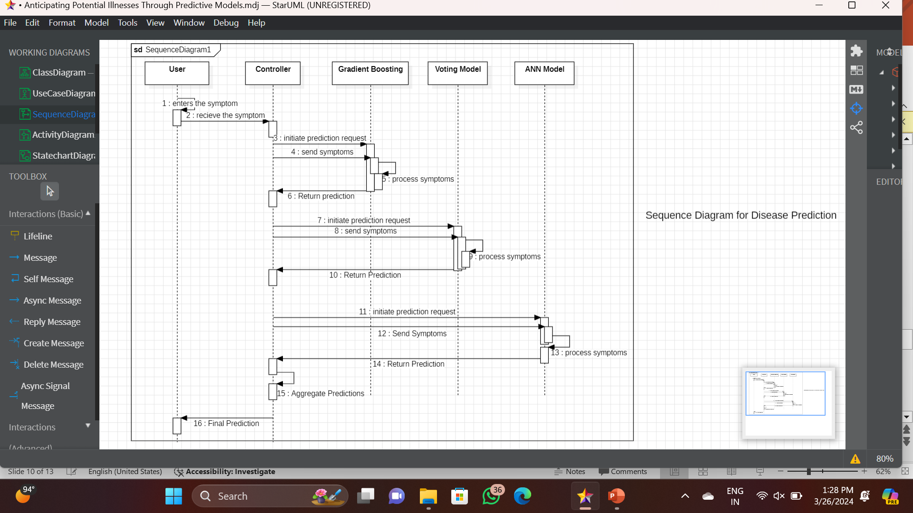

Slide 18
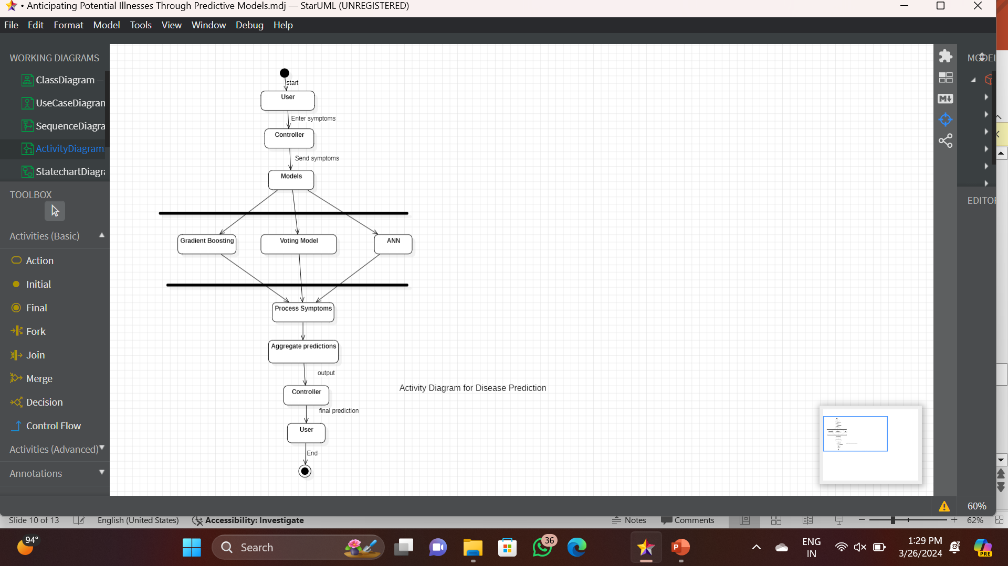

Slide 19
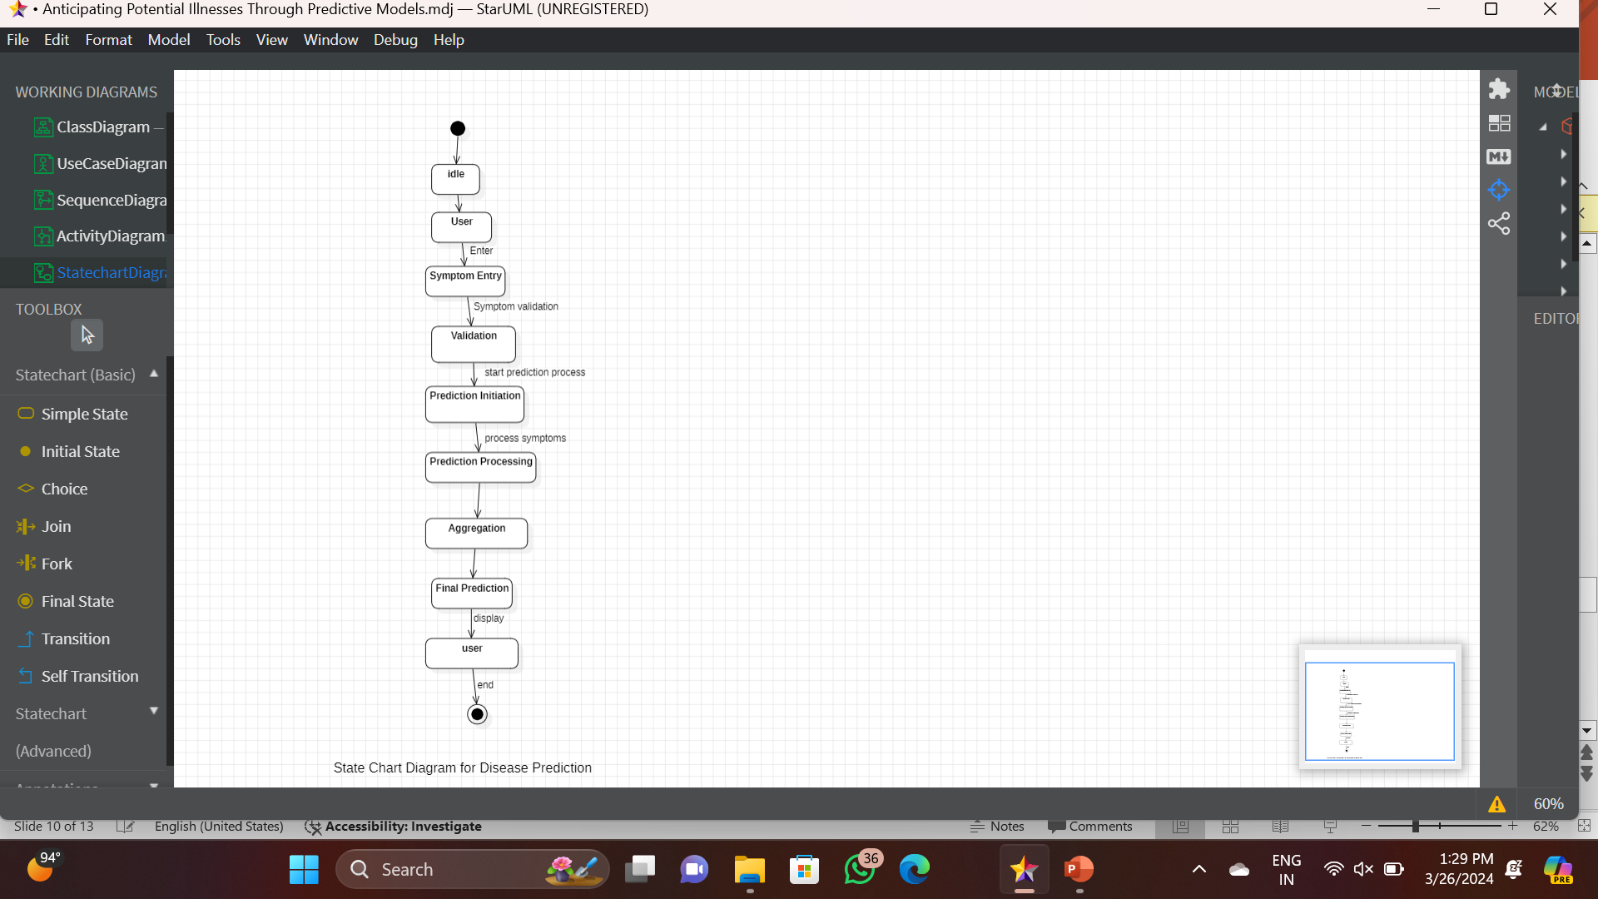

Slide 20
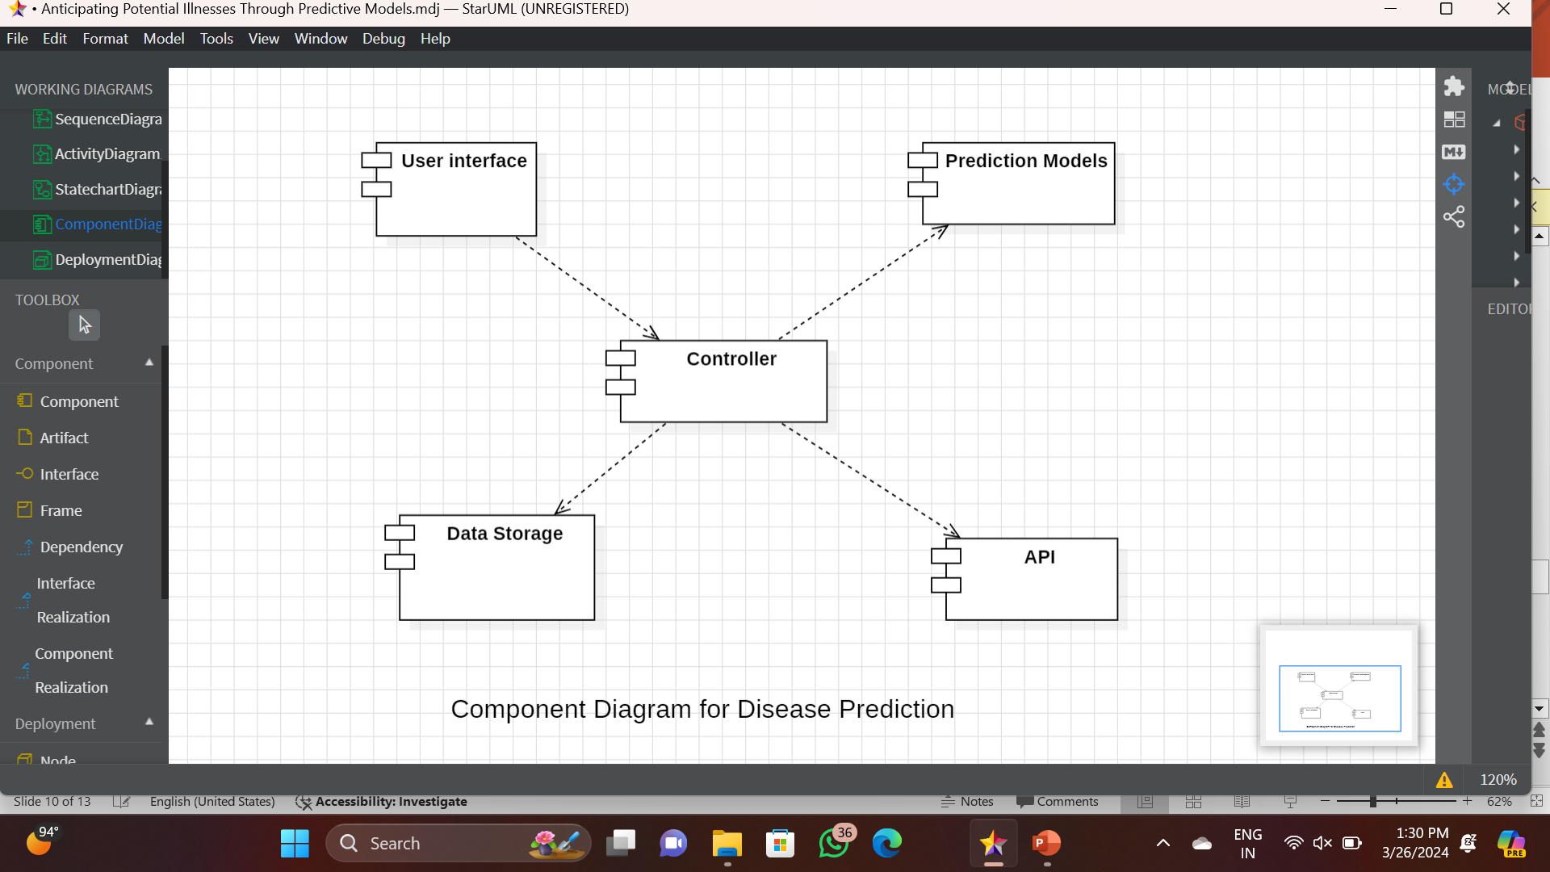

Slide 21
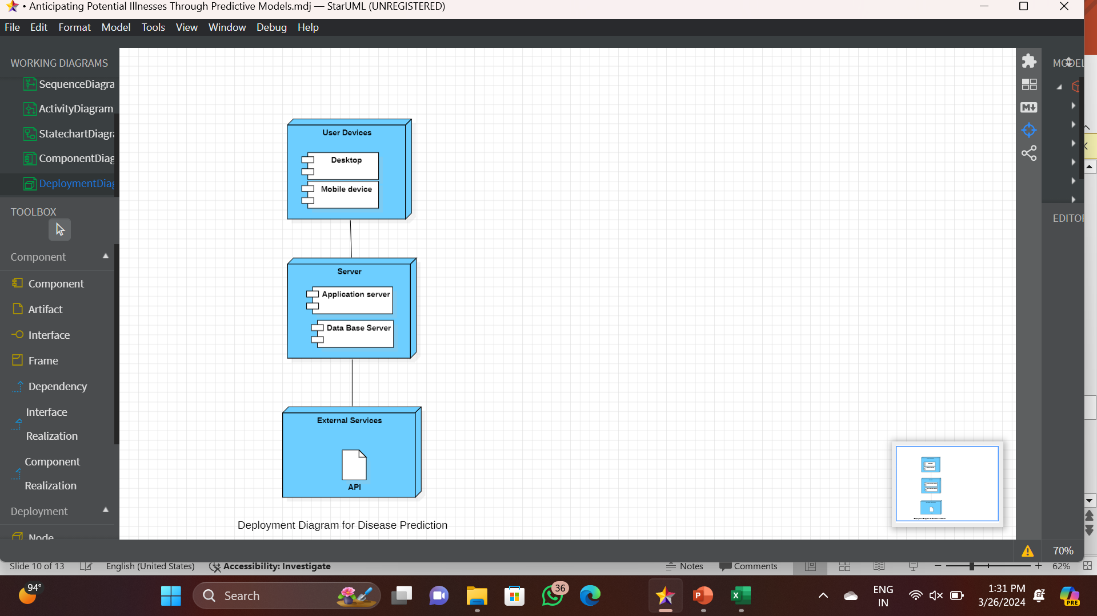

Slide 22
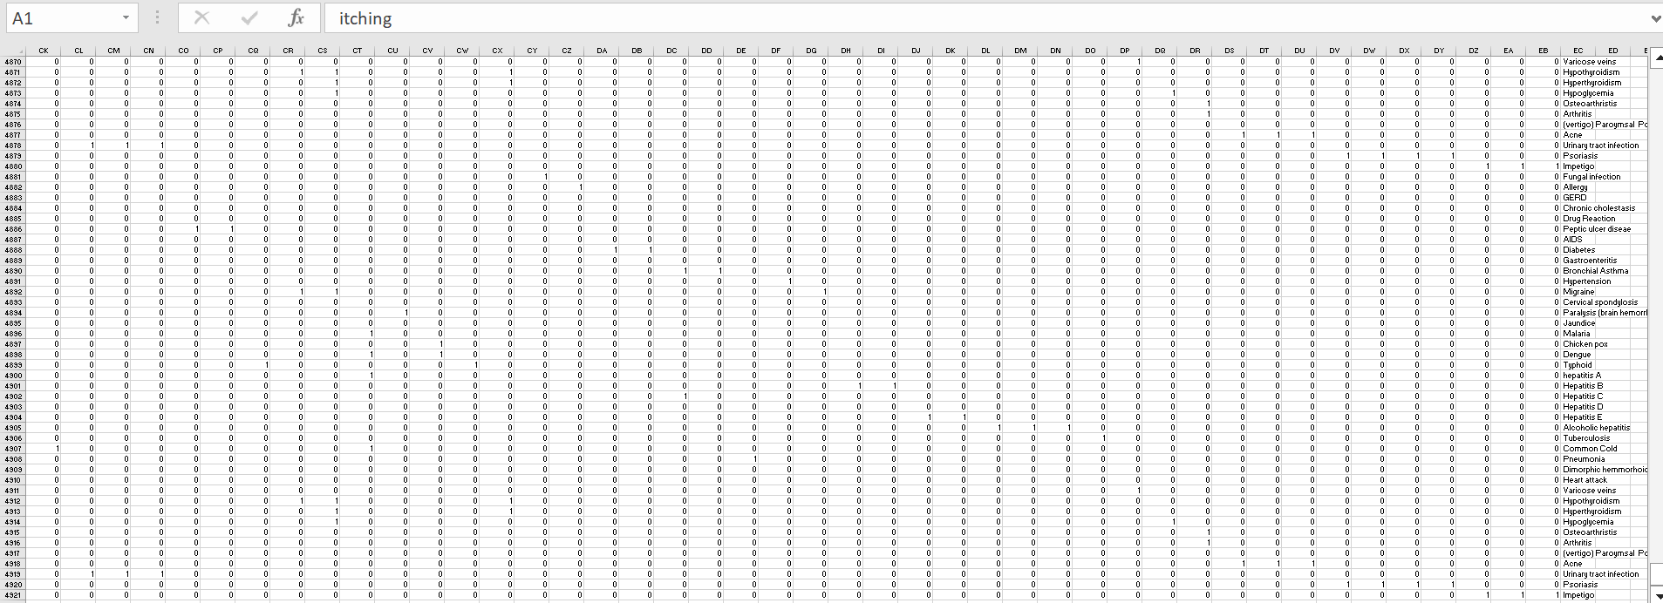
DATASET
TRAINING DATASET

Slide 23
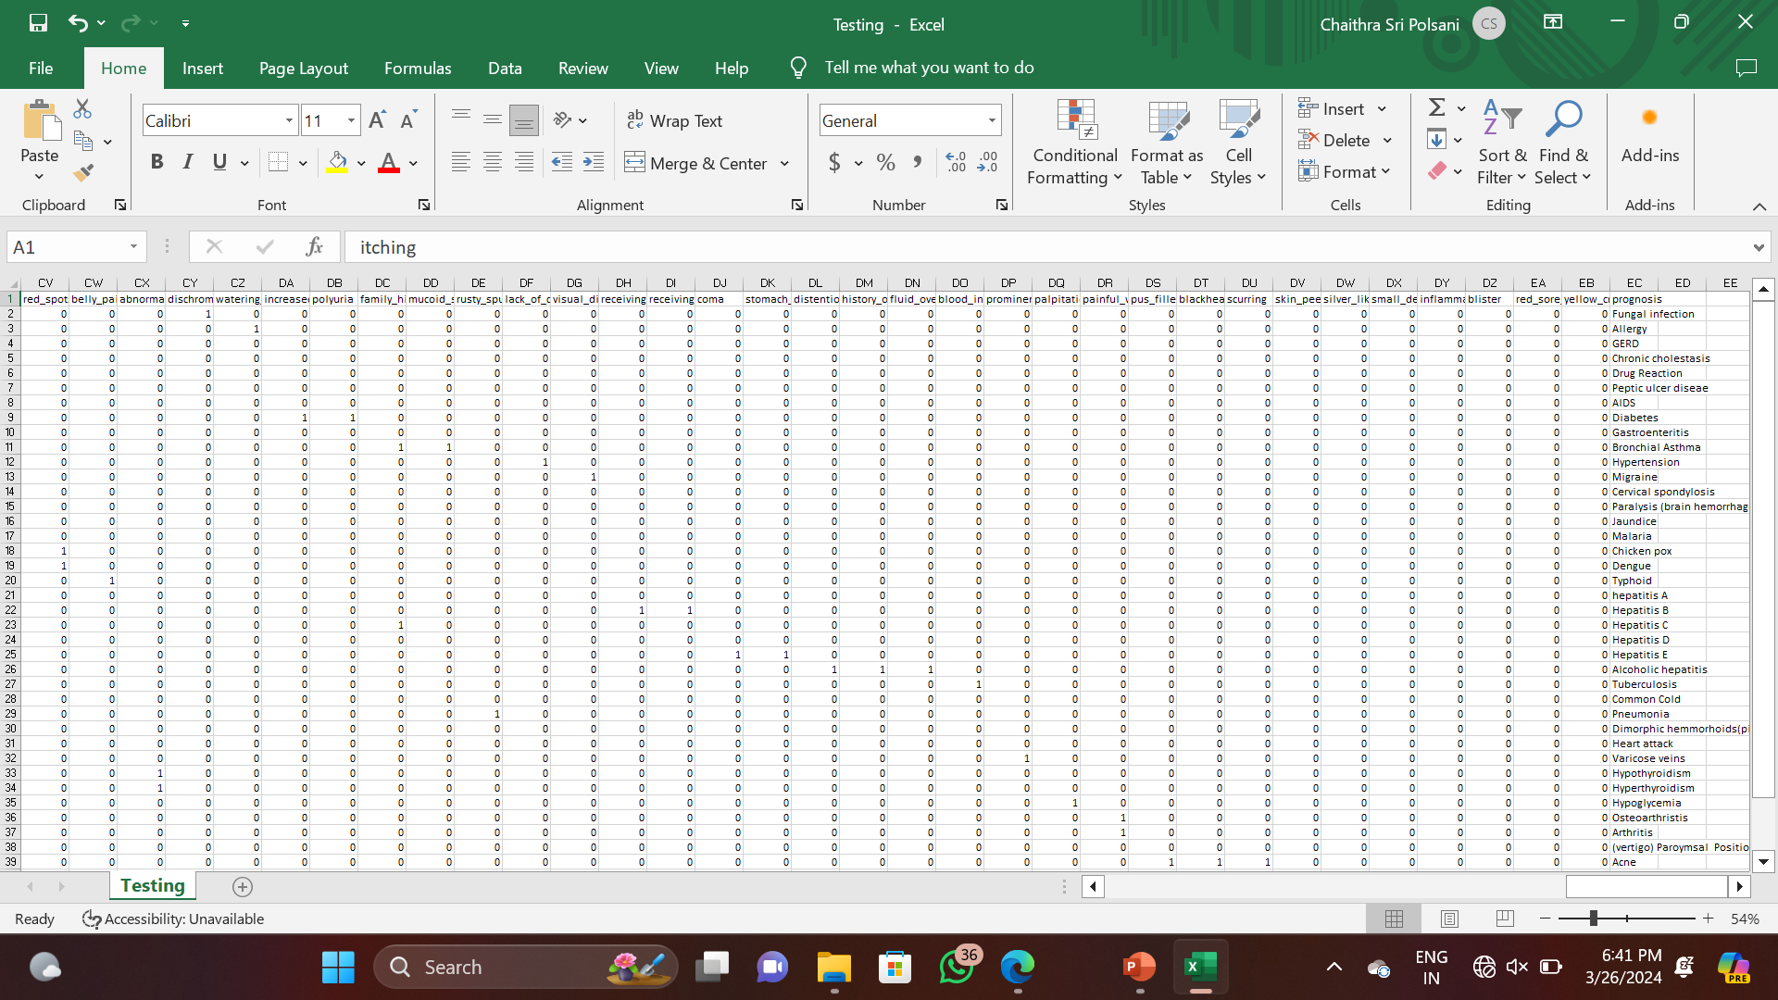
TESTING DATASET

Slide 24
DATASET DESCRIPTION
The dataset we have considered consists of 132 symptoms, the combination or permutations of which leads to 41 diseases. Based on the 4920 records of patients, we aim to develop a prediction model that takes in the symptoms from the user and predicts the disease he is more likely to have.
If symptom is present indicated by 1 if not present indicated by 0.
Some of the symptoms are:
Back pain , Constipation scurrying , Bloody stool , depression, Abdominal pain ,Passage of gases ,Irritation in anus ,diarrhea, Weakness in limbs, Mild fever, Fast heart rate , Neck pain, dizziness, Yellow urine, Internal itching, Toxic look, Yellowing of eyes ,palpitations, cramps, bruising ,Acute liver failure ,obesity ,Fluid overload ,Painful walking.
Some of the diseases are:
Fungal Infection, Malaria ,Varicose veins , Allergy , Chickenpox , Hypothyroidism , Gerd Dengue , Vertigo, Chronic cholestasis, Peptic ulcer disease, acne Drug reaction , Hepatitis A , Urinary tract infection, Piles, Hepatitis B, Psoriasis, AIDS, Hepatitis C , Impetigo Diabetes , Hepatitis D , Hyperthyroidism , Gastroenteritis , Hepatitis E , Hypoglycemia.

Slide 25
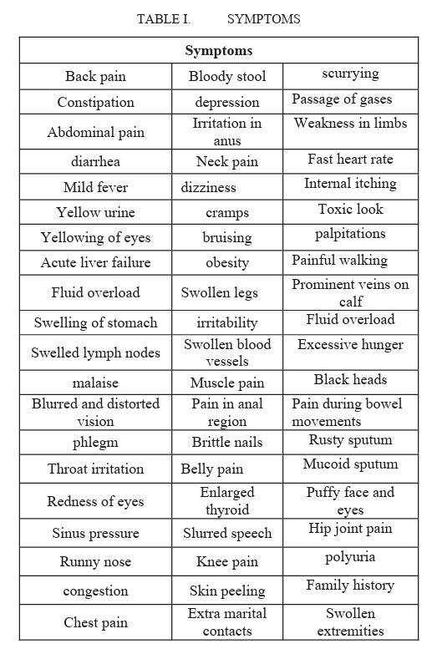
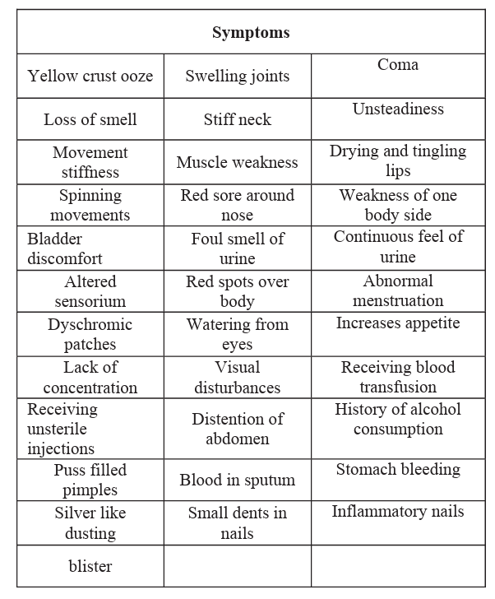

Slide 26
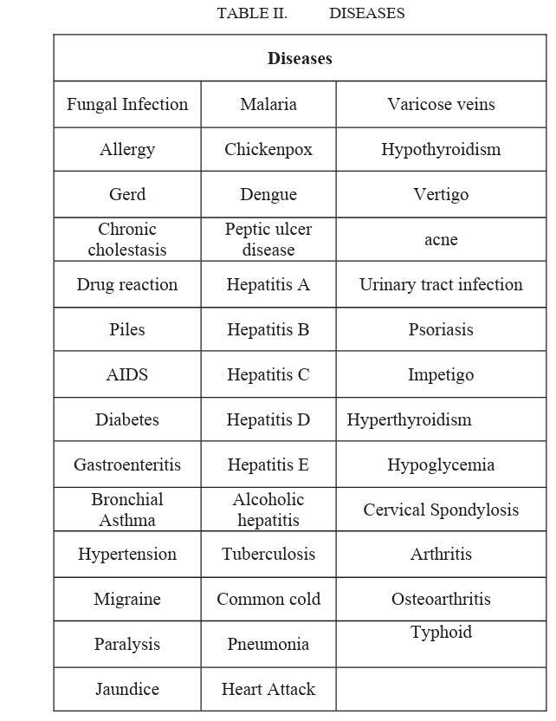

Slide 27
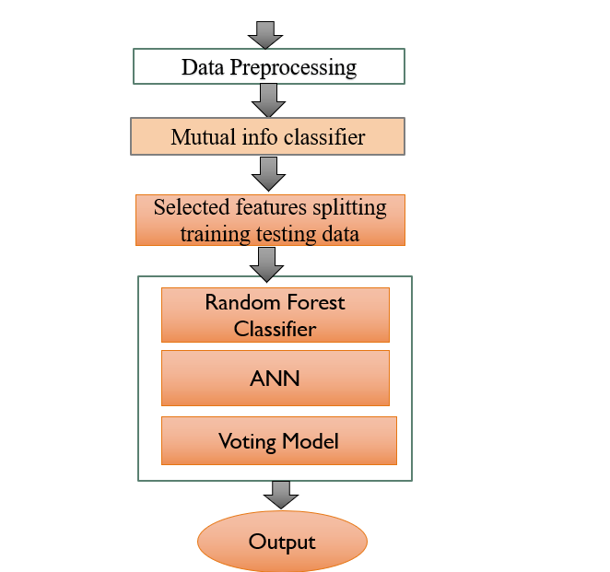
METHODOLOGY

Slide 28
Input (Symptoms): While designing the model we have assumed that the user has a clear idea about the symptoms he is experiencing. The Prediction developed considers 50 symptoms amidst which the user can give the symptoms his processing as the input.
Data preprocessing :The data mining technique that transforms the raw data or encodes the data to a form which can be easily interpreted by the algorithm is called data preprocessing. The preprocessing techniques used in the presented work are: Data Cleaning: Data is cleansed through processes such as filling in missing value, thus resolving the inconsistencies in the data. Data Reduction: The analysis becomes hard when dealing with huge database. Hence, we eliminate those independent variables(symptoms) which might have less or no impact on the target variable(disease). In the present work, 50 of 132 symptoms closely related to the diseases are selected.
Models selected :The system is trained to predict the diseases using three algorithms Voting Classifier Random forest Classifier Naïve Bayes Classifier ANN .A comparative study is presented at the end of work, thus analyzing the performance of each algorithm of the considered database.
Output(diseases): Once the system is trained with the training set using the mentioned algorithms a rule set is formed and when the user the symptoms are given as an input to the model, those symptoms are processed according the rule set developed, thus making classifications and predicting the most likely disease.

Slide 29
Random Forest Classifier:
Random forests are a popular supervised machine learning algorithm. Random forests are for supervised machine learning, where there is a labeled target variable. Random forests can be used for solving regression (numeric target variable) and classification (categorical target variable) problems. Random forests are an ensemble method, meaning they combine predictions from other models. Each of the smaller models in the random forest ensemble is a decision tree.
ANN:
An Artificial Neural Network (ANN) is a machine learning model inspired by the human brain's neural structure. It comprises interconnected nodes (neurons) organized into layers. Data flows through these nodes, adjusting the weights of connections to learn patterns and make predictions. ANNs can handle noisy or incomplete data, making them resilient to certain imperfections. They can generalize patterns from training data to make predictions on unseen data, thus providing robust performance even when faced with imperfect or partial information.
Voting Classifier:
A Voting Classifier is a machine learning model that trains on an ensemble of numerous models and predicts an output (class) based on their highest probability of chosen class as the output.

Slide 30
RESULTS
Algorithm used | Accuracy score
Random Forest | 98
ANN | 98
Voting Model | 98
From the above table, we can infer that all the algorithms have equal accuracy score. The accuracy in terms of percentage is: 98. percentage.

Slide 31
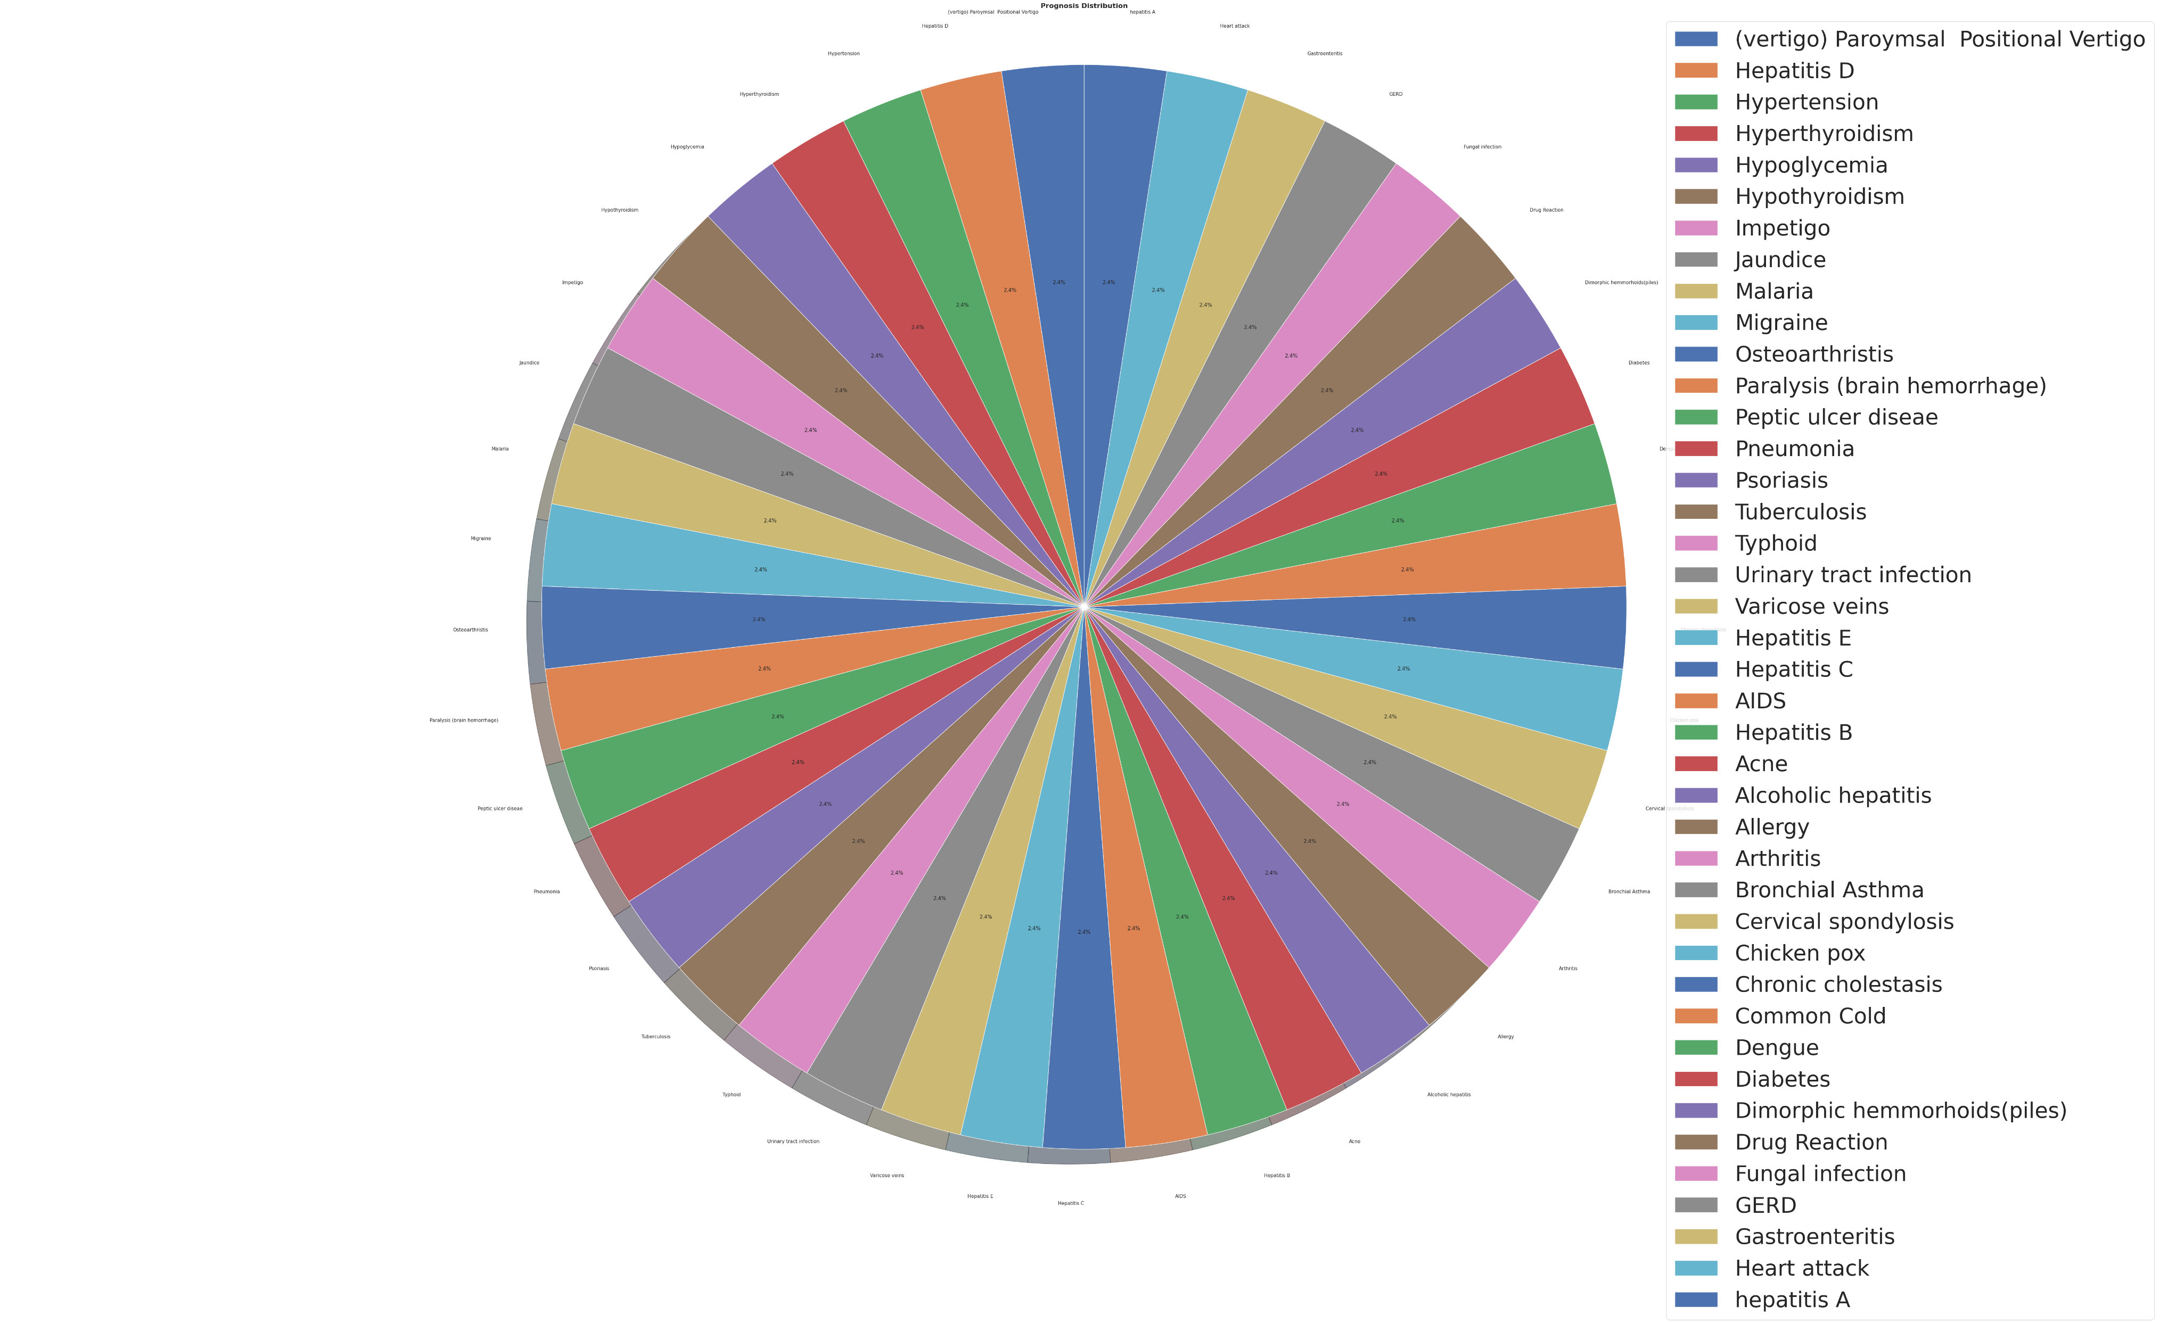
Fig:1: count of different prognosis

Slide 32
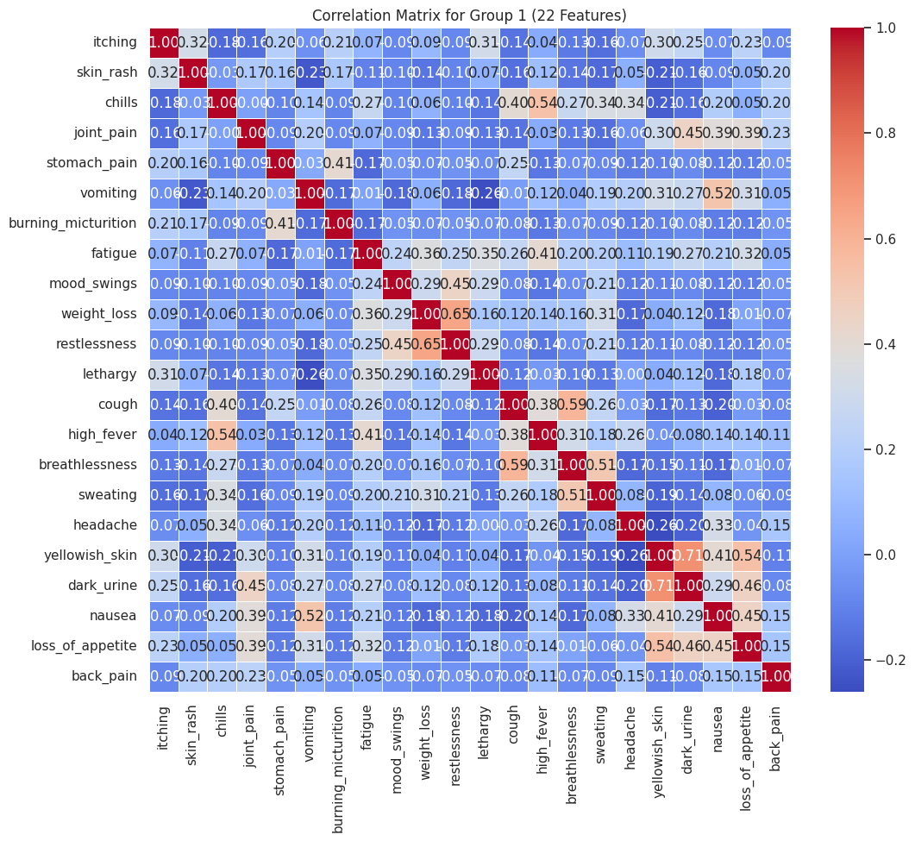

Slide 33
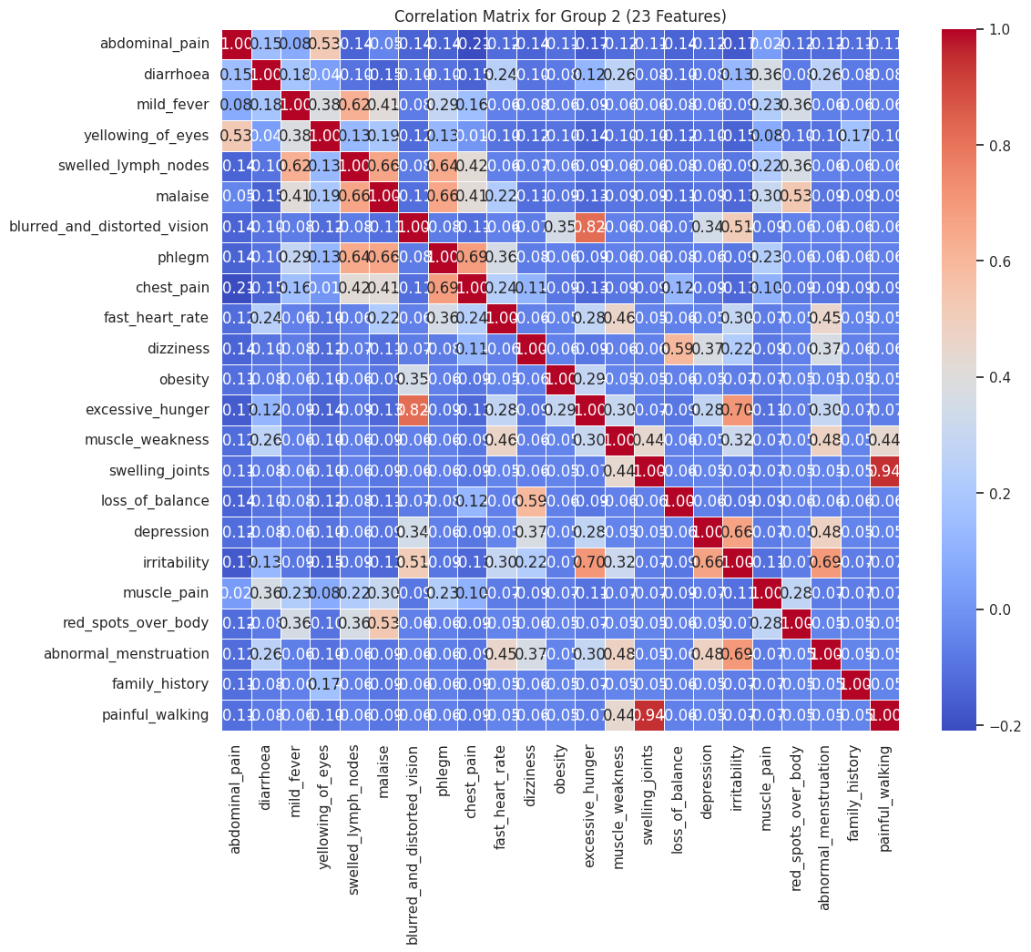
FIG:2: CORRELATION MATRIX FOR SELECTED FEATURES GROP2 23 FEATURES

Slide 34
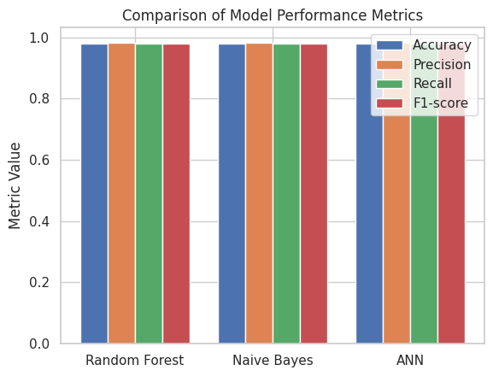
Fig: Compared all 3 models using different metrics

Slide 35
CONCLUSION
Our work presents a comprehensive comparative study of three algorithms performance on a medical record each yielding an accuracy up to 98 percent. The main difference from previous works is that we have implemented feature selection and reduced features to 50 symptoms and we have obtained accuracy of 98 percentage. The performance is analyzed through confusion matrix and accuracy score. Artificial Intelligence will play even more important role in data analysis in the future due to the availability of huge data produced and stored by the modern technology

Slide 36
FUTURE SCOPE
Artificial Intelligence will play even more important role in data analysis in the future due to the availability of huge data produced and stored by the modern technology . Prospective research in the healthcare arena could focus on the promising field of symptom-based disease prediction. Explainable artificial intelligence (XAI) can help us make more accurate comorbidity forecasts and make the reasons behind those predictions understandable. This can enhance patient outcomes by assisting healthcare professionals in making well-informed decisions. Finding new illness connections and learning more about the mechanisms behind diseases can both be aided by the integration of genomic and electronic health record (EHR) data. This may result in early diagnosis and better care quality.

Slide 37
REFERENCES
[1]Grampurohit, S., & Sagarnal, C. (2020, June). Disease prediction using machine learning algorithms. In 2020 International Conference for Emerging Technology (INCET) (pp. 1-7). IEEE.
[2]Uddin, S., Khan, A., Hossain, M. E., & Moni, M. A. (2019). Comparing different supervised machine learning algorithms for disease prediction. BMC medical informatics and decision making, 19(1), 1-16.
[3]Dahiwade, D., Patle, G., & Meshram, E. (2019, March). Designing disease prediction model using machine learning approach. In 2019 3rd International Conference on Computing Methodologies and Communication (ICCMC) (pp. 1211-1215). IEEE.
[4]Nilashi, M., bin Ibrahim, O., Ahmadi, H., & Shahmoradi, L. (2017). An analytical method for diseases prediction using machine learning techniques. Computers & Chemical Engineering, 106, 212-223.
[5]Arumugam, K., Naved, M., Shinde, P. P., Leiva-Chauca, O., Huaman-Osorio, A., & Gonzales-Yanac, T. (2023). Multiple disease prediction using Machine learning algorithms. Materials Today: Proceedings, 80, 3682-3685.

Slide 38
[6]Yu, Z., Wang, K., Wan, Z., Xie, S., & Lv, Z. (2023). Popular deep learning algorithms for disease prediction: a review. Cluster Computing, 26(2), 1231-1251.
[7]Yaqoob, A., Aziz, R. M., Verma, N. K., Lalwani, P., Makrariya, A., & Kumar, P. (2023). A review on nature-inspired algorithms for cancer disease prediction and classification. Mathematics, 11(5), 1081.
[8]Sun, W., Zhang, P., Wang, Z., & Li, D. (2021). Prediction of cardiovascular diseases based on machine learning. ASP Transactions on Internet of Things, 1(1), 30-35.
[9]Nemade, V., & Fegade, V. (2023). Machine Learning Techniques for Breast Cancer Prediction. Procedia Computer Science, 218, 1314-1320.
[10]Chaubey, G., Bisen, D., Arjaria, S., & Yadav, V. (2021). Thyroid disease prediction using machine learning approaches. National Academy Science Letters, 44(3), 233-238.

Slide 39
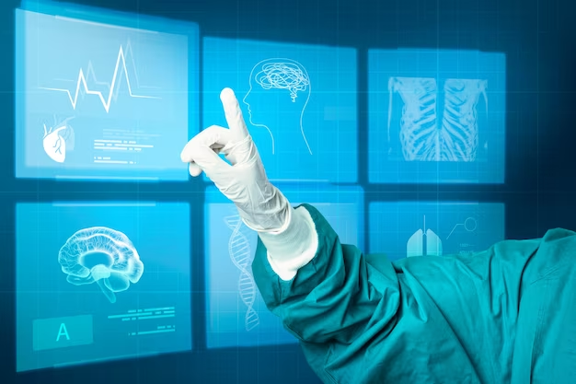
THANK YOU !

